Slide 1
MATH TIME

Slide 2
Probability
Suppose there’s an event space S = {s₁, s₂, …, s_{n}}
Axioms of probability:
For any event s_{i}, 0 ≤P(s_{i})≤1
P(s₁) + P(s₂) + … + P(s_{n}) = 1
If s_{i} and s_{j} are mutually exclusive, P(s_{i} or s_{j}) = P(s_{i}) + P(s_{j})

Slide 3
Basic but Important Concepts
Conditional Probability
P(A|B) = P(A ∩B)/P(B)
Independence
If A and B are independent, P(A ∩B) = P(A)P(B). Alternatively, P(A|B) = P(A)

Slide 4
Discrete Probability
Event space has countable number of elements
Examples
Dice rolls
Flipping coins
Number of people in trading club meetings
Uses probability mass function
Maps an event to a probability
Examples
Discrete Uniform Distribution
Binomial Distribution
Poisson Distribution
Geometric Distribution
etc...

Slide 5
Continuous Probability
Event space has uncountable number of elements
Examples
Height of students
Time between two online purchases
Time it takes for a person to make slides on probability
Uses probability density function
Maps event to a density (requires integration when computing probability)
Examples
Uniform Distribution
Exponential Distribution
Normal Distribution
Beta Distribution
etc...

Slide 6
Expected value
Discrete: E(X) = Σxp(x)
Continuous: E(X) = ∫xf(x)dx
“Expected payoff” “Expected return”

Slide 7
Interview Questions
Given 100 coin flips, what is the probability that you get an even number of heads?
5 friends walked into a restaurant. They all had a different birthday. There was a round table with 5 seats around it. What is the probability that they sit down in correct age order either clockwise or counter clockwise?
You flip four fair coins, if you get 4 heads I will give you $10.00. You pay me $1.00 to play. Should you play?

Slide 8
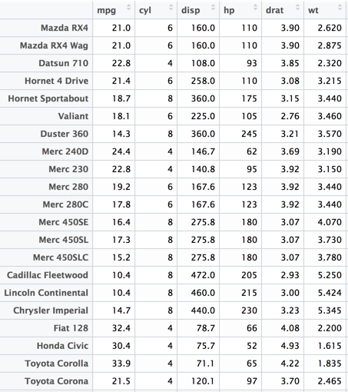
Regression
Dependent variable: y
Independent variables: x₁, x₂, …, x_{n}
Output model: y = 𝛽₀+ 𝛽₁x₁ + 𝛽₂x₂ + ...+ 𝛽_{n}x_{n}

Slide 9
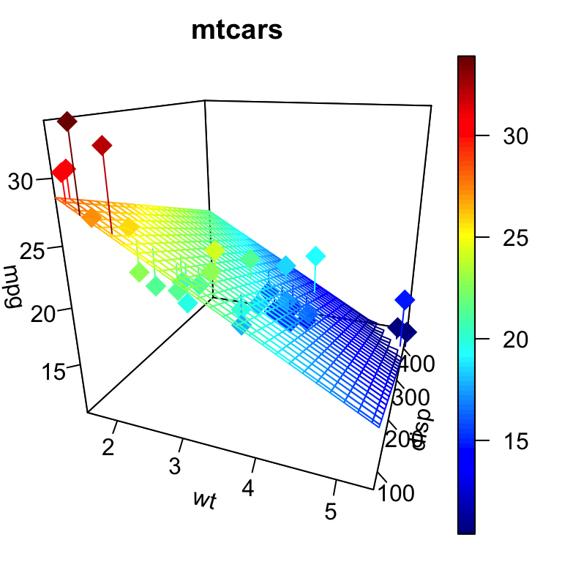
How it works
Method of least square
Minimize the sum of squared residual

Slide 10
Conditions
Linearity
Independence
Normality
Equal Variance (Homoscedasticity)
(No or small multicollinearity)

Slide 11
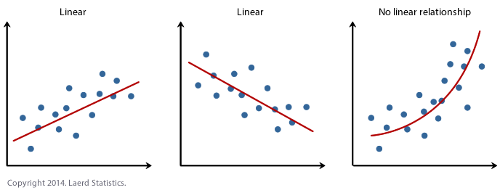
Linearity

Slide 12
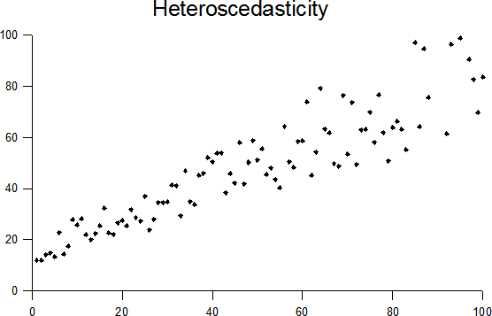
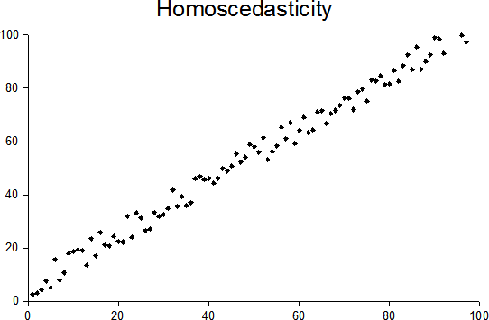
Homoscedasticity
GOOD
BAD

Slide 13
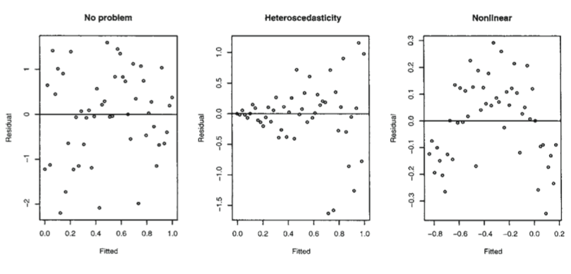

Slide 14
Independence
Residual from one observation is independent from the residual of any other observation
Just check if data collection methodology makes sense

Slide 15
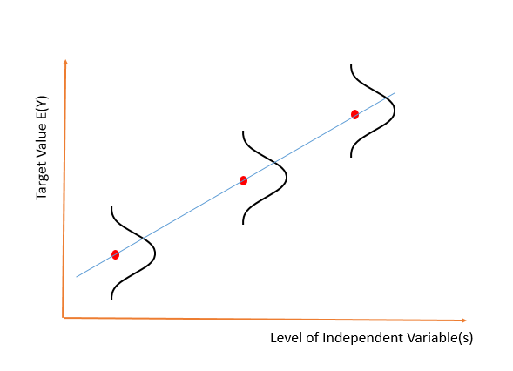
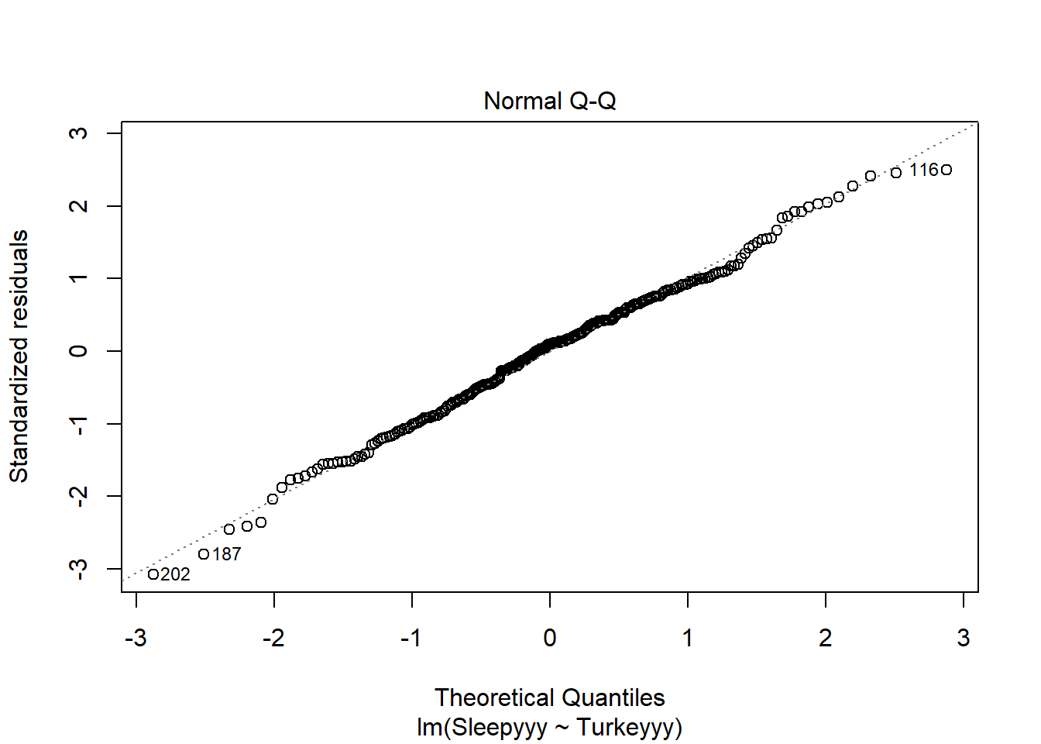
Normality

Slide 16
Multicollinearity
Correlation between predictors
Can make model coefficients unreliable
Hard to interpret model
Fine for prediction
Example:
Suppose y is the dependent variable and x₁ and x₂ are independent variable.
Suppose x₁ and x₂ are perfectly collinear with relationship x₁ = 2x₂
Regression can output models like y = 3x₁ + 2x₂
HOWEVER y = 4x₁ is also true and so is y=8x₂ , y = 7x₁ + 2x₂ , etc...

Slide 17
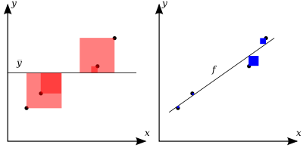

Evaluating Models
R² / Adjusted R²
MSE
F-test/p-values

